Slide 1


Slide 2

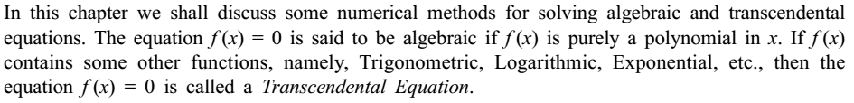
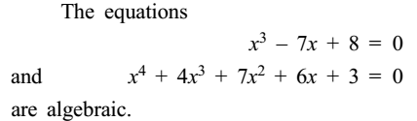

Numerical Methods
National University of Science and Technology, Islamabad

Slide 3
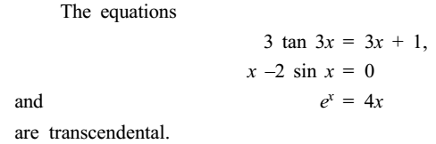
Numerical Methods
National University of Science and Technology, Islamabad

Slide 4
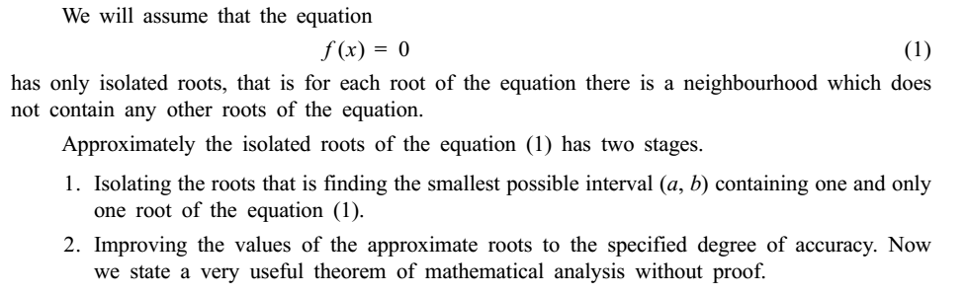
Numerical Methods
National University of Science and Technology, Islamabad

Slide 5
Numerical Methods
National University of Science and Technology, Islamabad

Slide 6
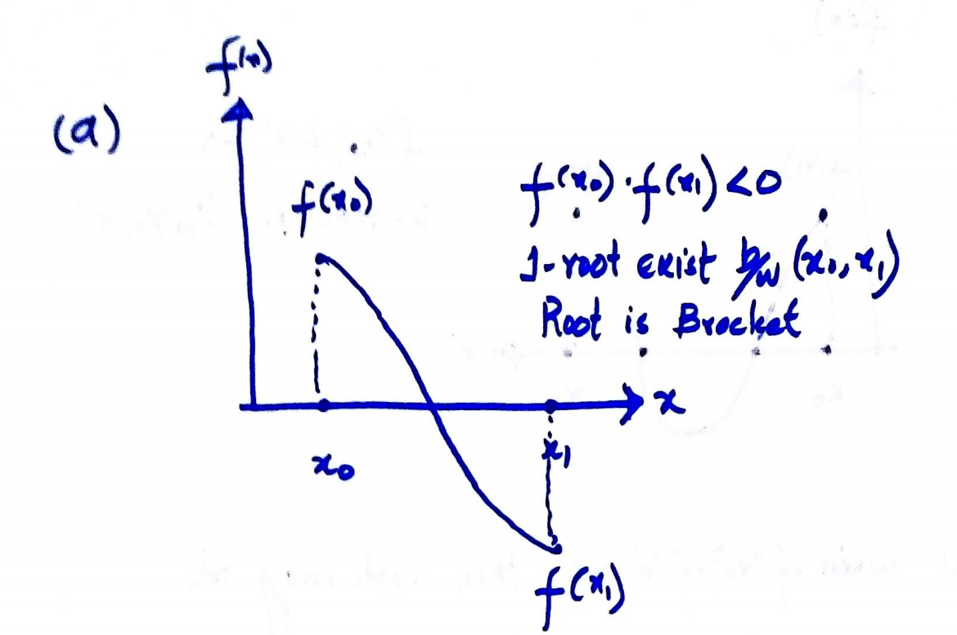
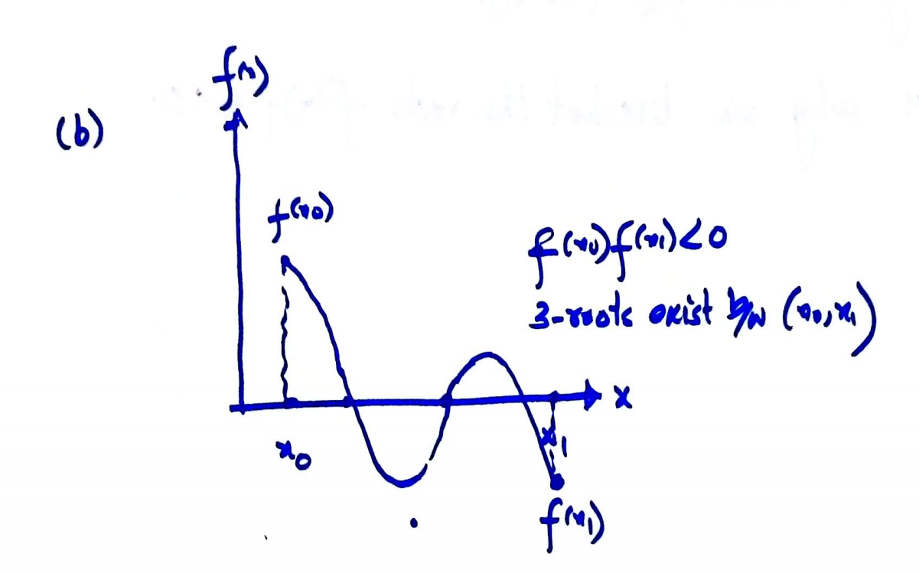
Numerical Methods
National University of Science and Technology, Islamabad

Slide 7
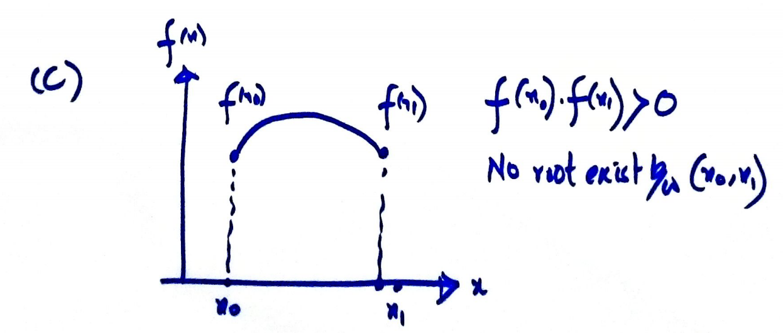
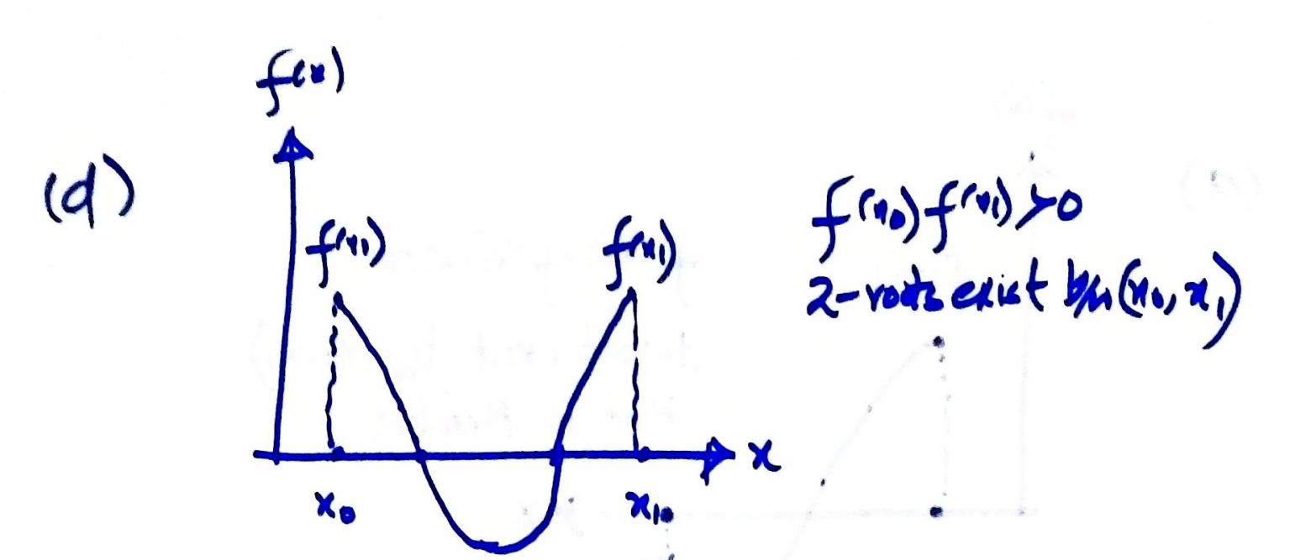
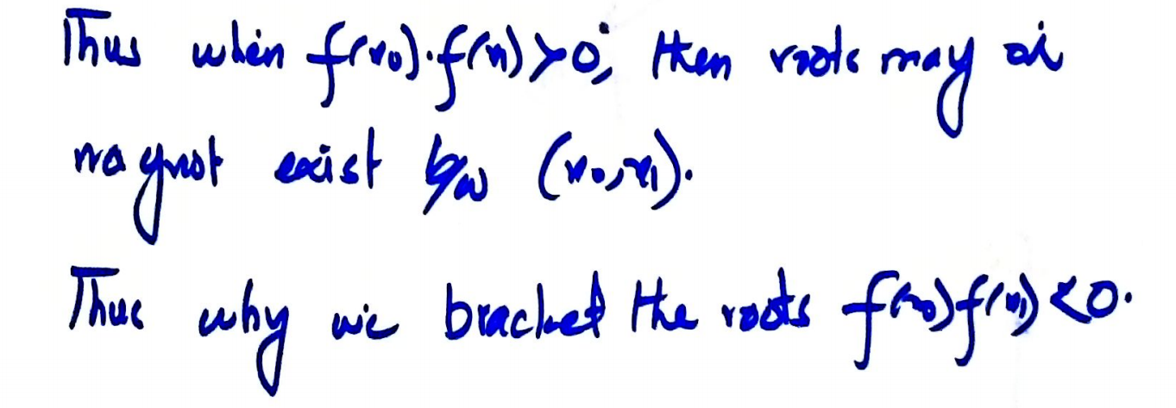
Numerical Methods
National University of Science and Technology, Islamabad

Slide 8
Numerical Methods
Types of Numerical Methods:
There are two types of numerical methods
Closed or Bracketing Methods
Open or Iterative Methods
Bracketing Methods:
Bracketing methods or closed methods are the methods in which we bracket the roots.
Types of Bracketing Methods:
Bisection Method
Regula-Falsi Method or False Position Method
National University of Science and Technology, Islamabad

Slide 9
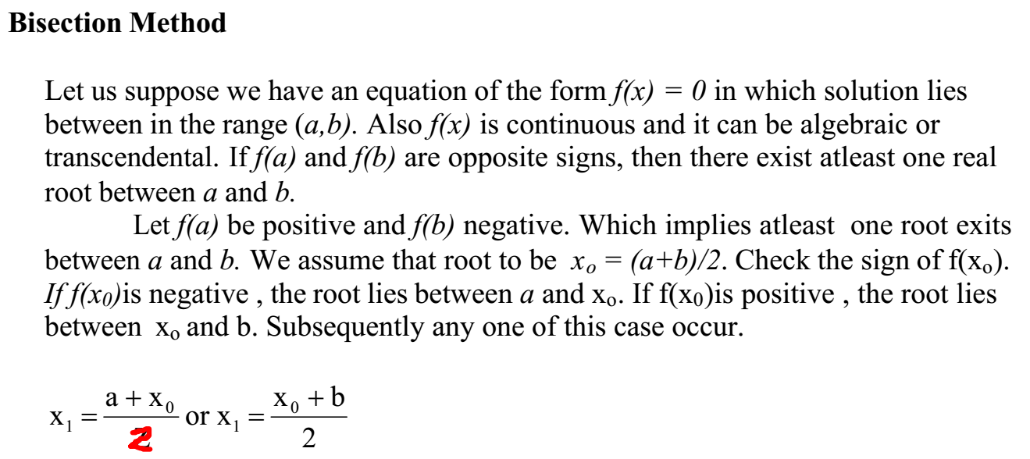
Numerical Methods
National University of Science and Technology, Islamabad

Slide 10
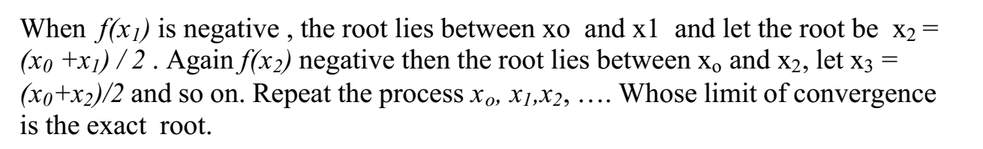
Numerical Methods
National University of Science and Technology, Islamabad

Slide 11
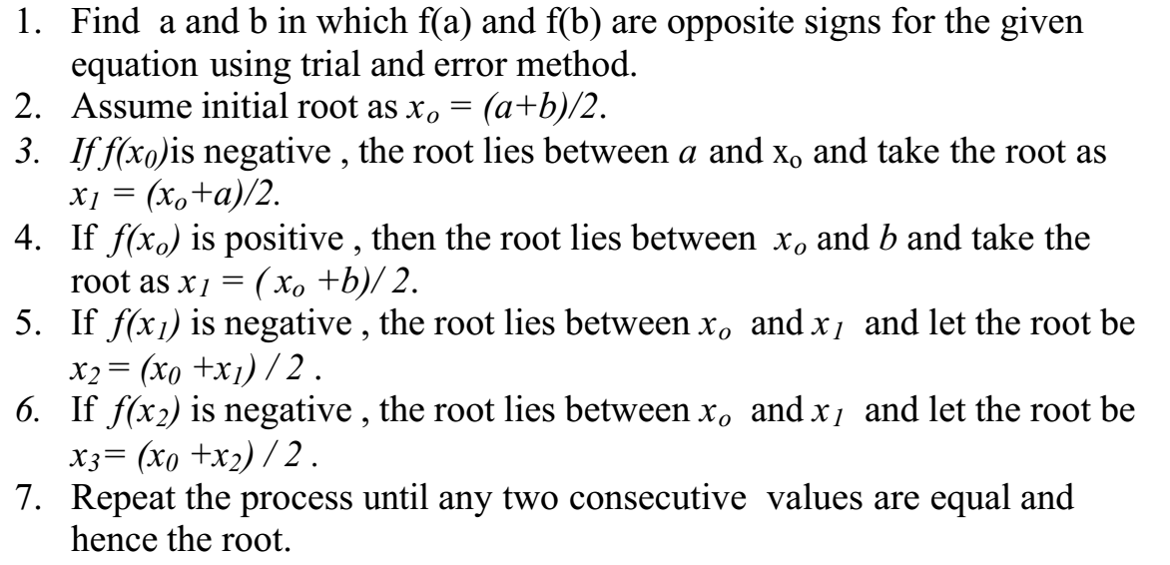
Numerical Methods
Working Steps for Bisection Method (Algorithm)
National University of Science and Technology, Islamabad

Slide 12
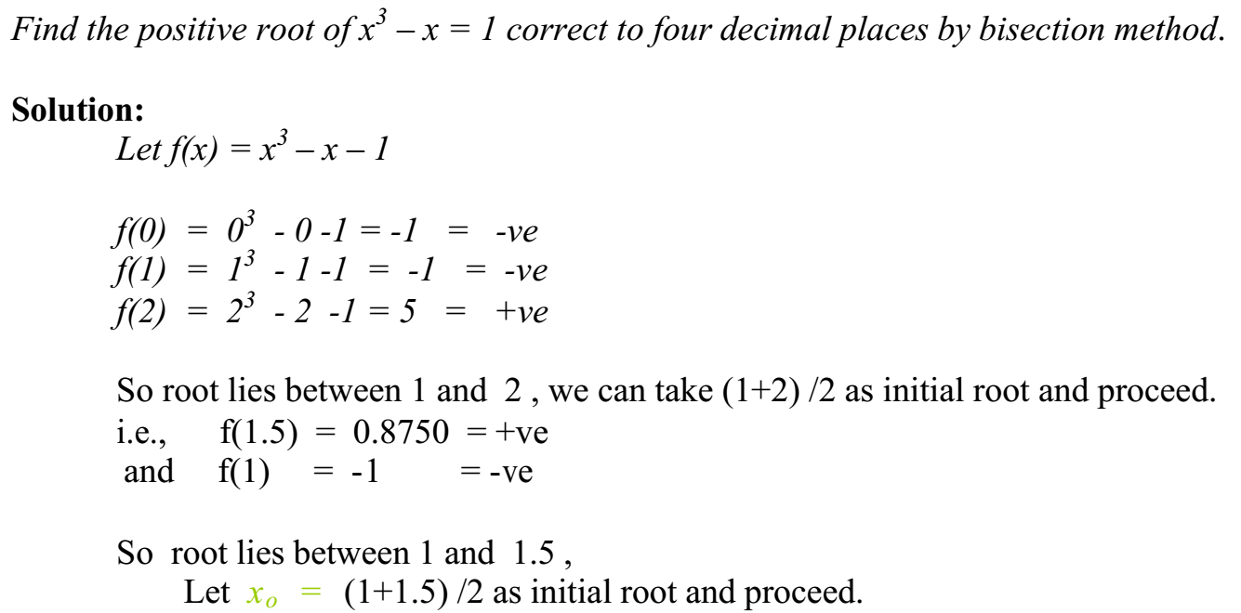
Numerical Methods
Example. 1:
National University of Science and Technology, Islamabad

Slide 13
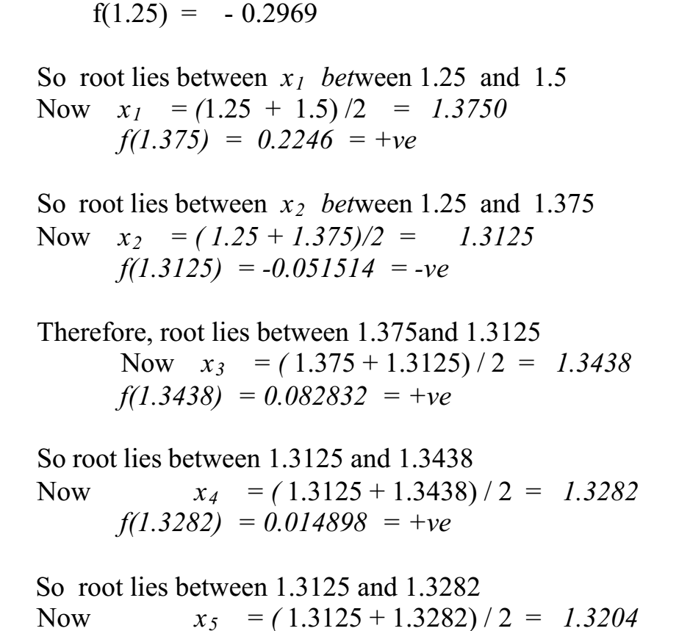
Numerical Methods
National University of Science and Technology, Islamabad

Slide 14
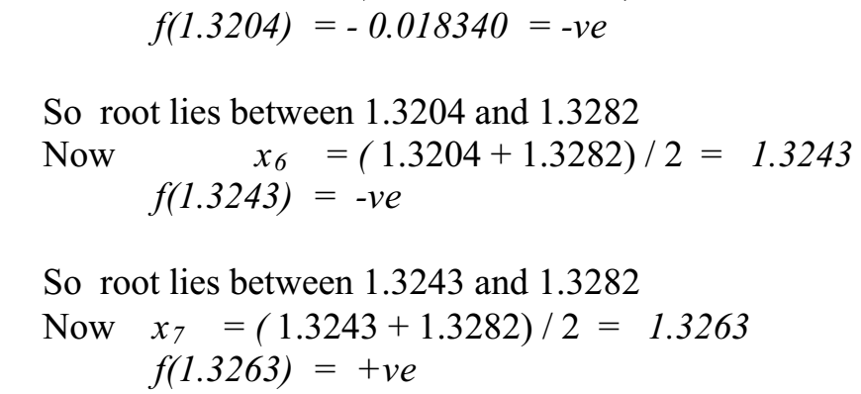
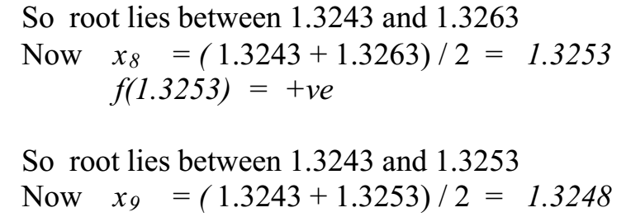
Numerical Methods
National University of Science and Technology, Islamabad

Slide 15
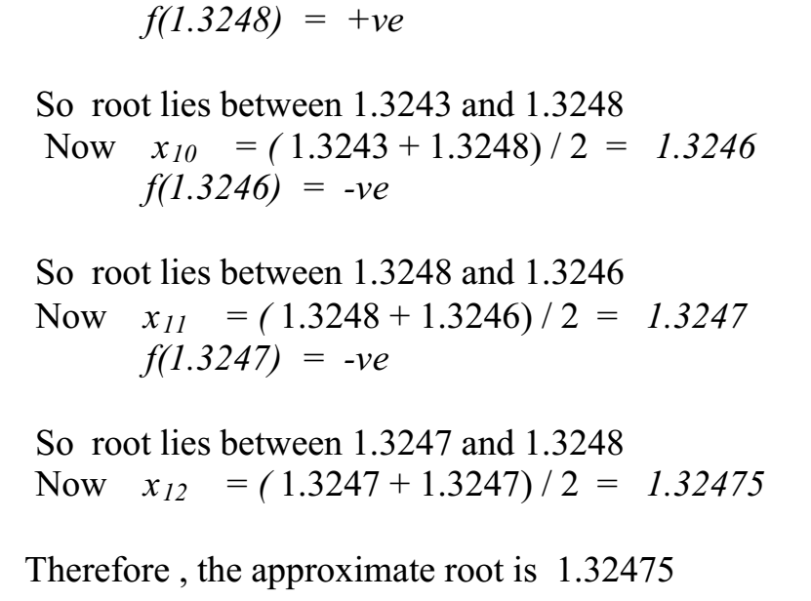
Numerical Methods
National University of Science and Technology, Islamabad

Slide 16
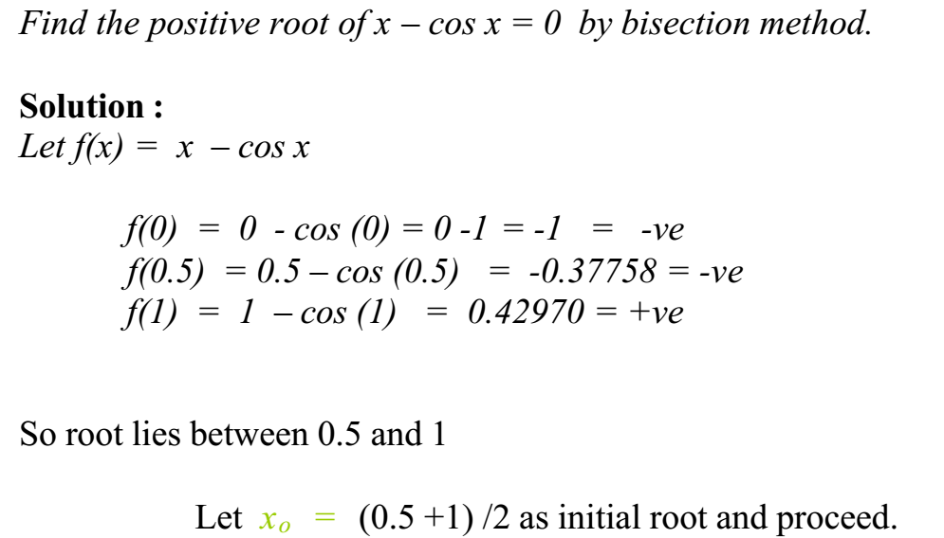
Numerical Methods
Example. 2:
Note: Calculator must in Radian Mode when f(x) involves Trigonometric functions
National University of Science and Technology, Islamabad

Slide 17
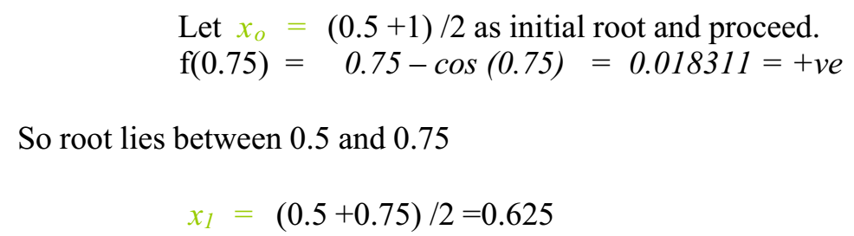
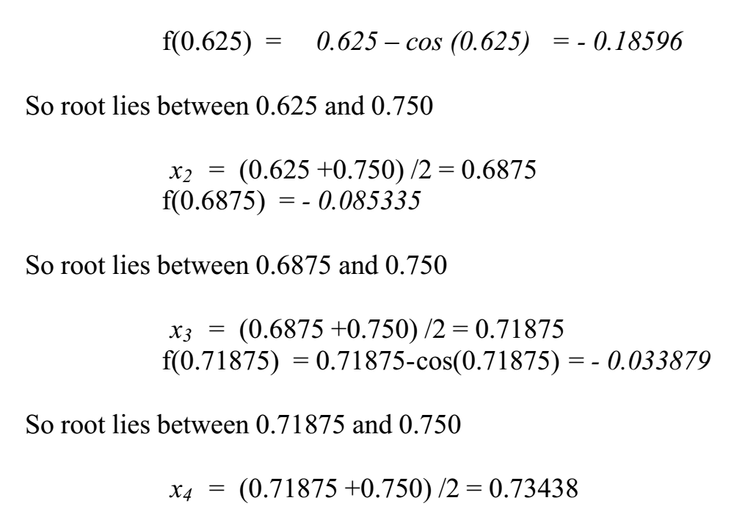
Numerical Methods
National University of Science and Technology, Islamabad

Slide 18
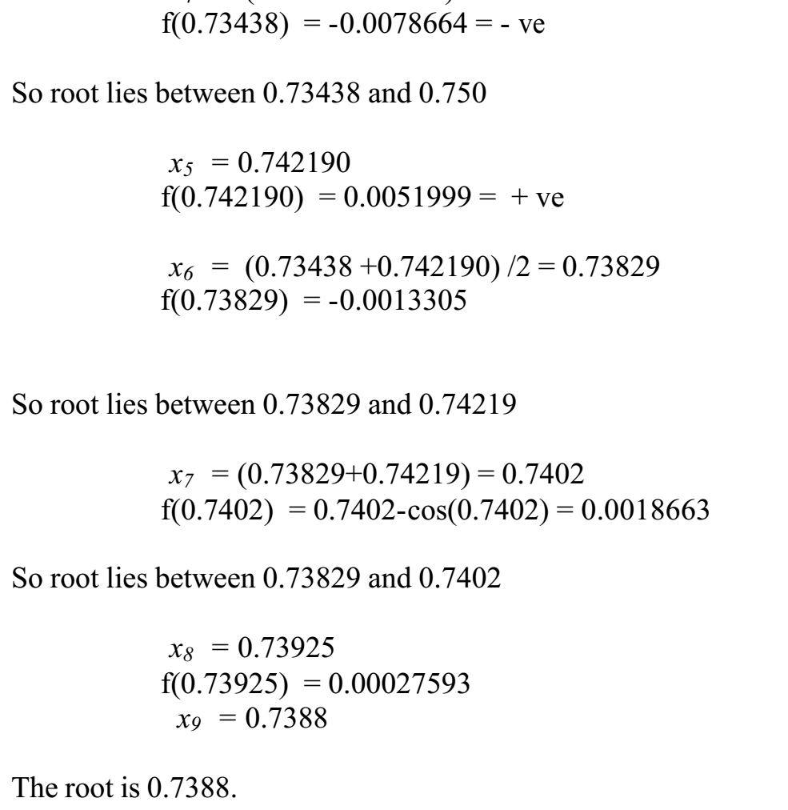
Numerical Methods
National University of Science and Technology, Islamabad

Slide 19
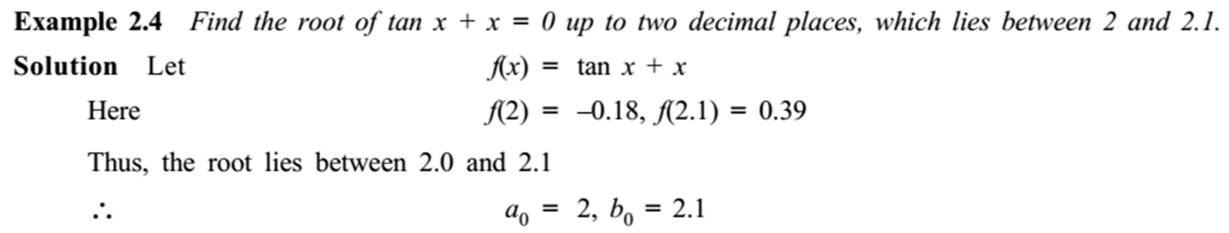

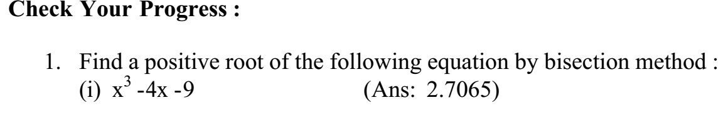
Numerical Methods
National University of Science and Technology, Islamabad

Slide 20
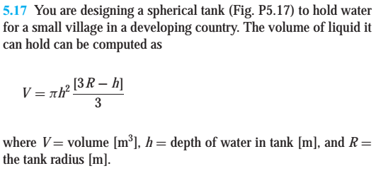
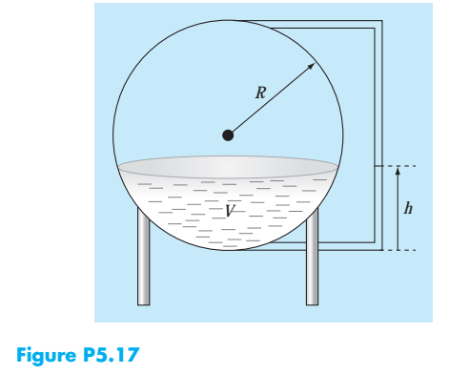
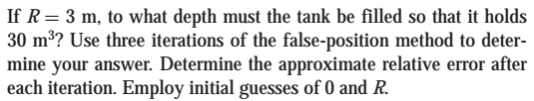
Numerical Methods
National University of Science and Technology, Islamabad

Slide 21
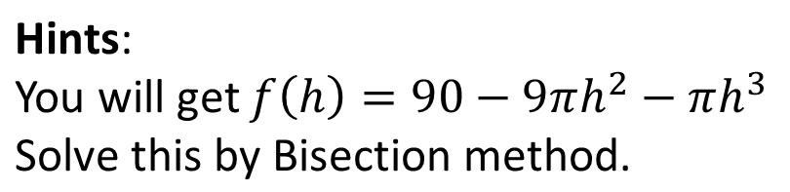
Numerical Methods
National University of Science and Technology, Islamabad

Slide 22
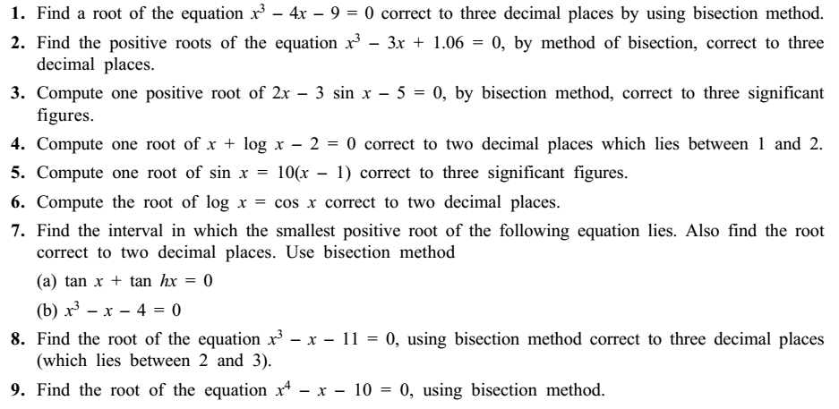
Numerical Methods
Practice Questions on Bisection Method
National University of Science and Technology, Islamabad

